Slide 1


The Data Science Job Market
Exploring Trends, Opportunities, and Insights
By Anvita Iyer, Brian Hester, Crystal Gonzales, Emeka Osasah, and Sam Williamson
Team 2 – Project 3

Slide 2

TABLE OF CONTENTS
01.
Project Overview
02.
Understanding the Global Demand
03.
Salary Trends
04.
Remote Work Opportunities
05.
Career Pathways and Job Titles
06.
Key Takeaways

Slide 3

logo
Team 2 Project
PART 1
Project Overview

Slide 4

OBJECTIVES
Analyze
Summarize
Analyze the demand, categories, and geographical locations of the Data Science job market.
Provide actionable insights and recommendations for job seekers, employers, and educators..

Slide 5
Global Job Density for Data Science Roles
industryPPTtemplatehttp://www.1ppt.com/hangye/
Notes:
Dark Red indicates the highest job density with Dark Blue as the lowest job density.
Visually source countries for jobs is apparent.
Emerging markets such as India, Australia, and New Zealand exhibit growing job opportunities.

Slide 6
logo
Team 2 Project
PART 2
Understanding the
Global Demand

Slide 7
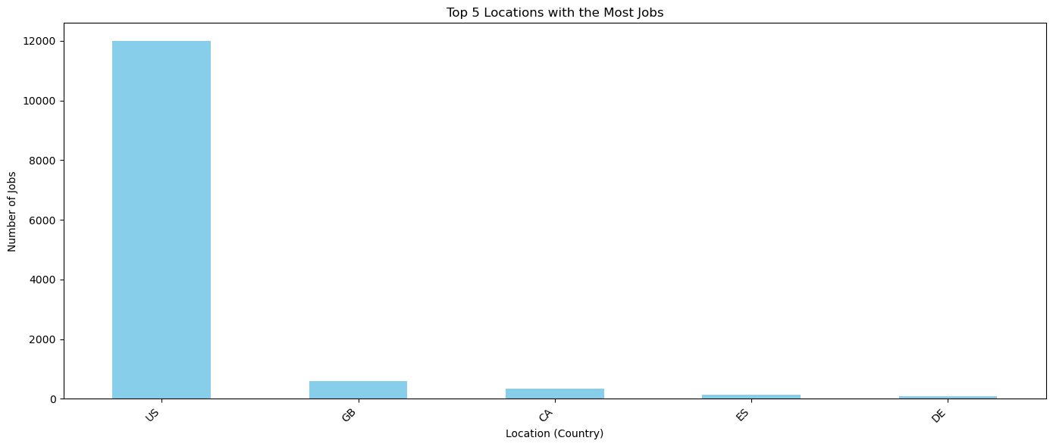
Top 5 Locations with the Most Data Science Jobs
industryPPTtemplatehttp://www.1ppt.com/hangye/
Notes:
The United States (US) overwhelmingly dominates the job market, offering more than 12,000 positions.
Other locations like the United Kingdom (GB), Canada (CA), Spain (ES), and Germany (DE) contribute significantly but lag far behind the US.
The US is the primary hub for data science opportunities, dwarfing other countries in job availability.

Slide 8
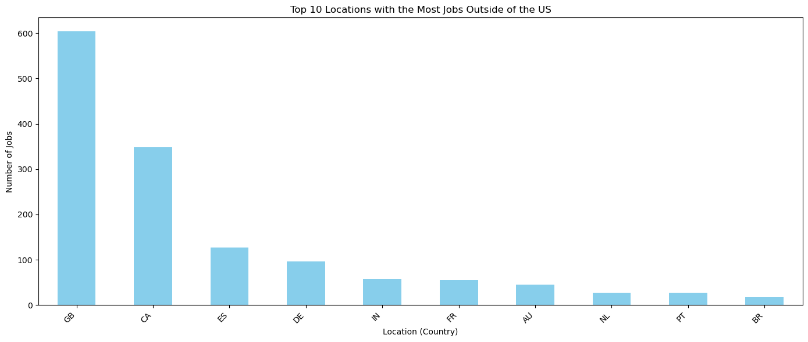
Top 10 Locations Outside the US
industryPPTtemplatehttp://www.1ppt.com/hangye/
Notes:
The United Kingdom (GB) leads with the highest number of jobs, surpassing all other countries.
Canada (CA) and Spain (ES) follow, offering significant job opportunities.
Germany (DE) and India (IN) also feature prominently, showcasing strong demand in these regions.
Other notable countries include France (FR), Australia (AU), and Netherlands (NL), contributing to a globally diverse job market.

Slide 9
logo
Team 2 Project
PART 3
Salary Trends

Slide 10
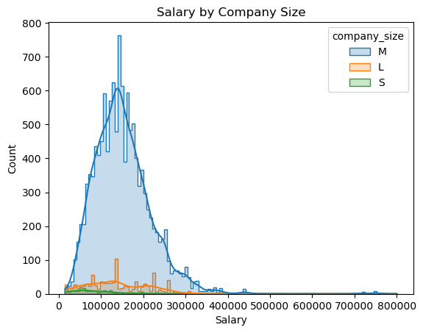
Notes:
Medium-sized companies (M) dominate, offering the widest salary range, with a strong concentration around $100,000-$150,000.
Large companies (L) have fewer employees in higher salary brackets, but their salary distribution is broader.
Small companies (S) have the lowest salary range, concentrated primarily under $100,000.
Salary opportunities are most concentrated and competitive in medium-sized companies.

Slide 11
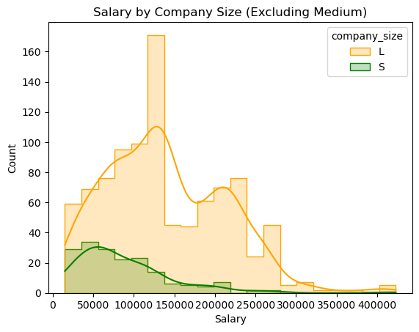
Notes:
Large companies (L) have a broader salary distribution, with peaks around $150,000.
Small companies (S) have lower salaries concentrated below $100,000.
Salaries at large companies show greater variability, offering opportunities for higher compensation.
Small companies maintain a tighter and more consistent salary range.

Slide 12
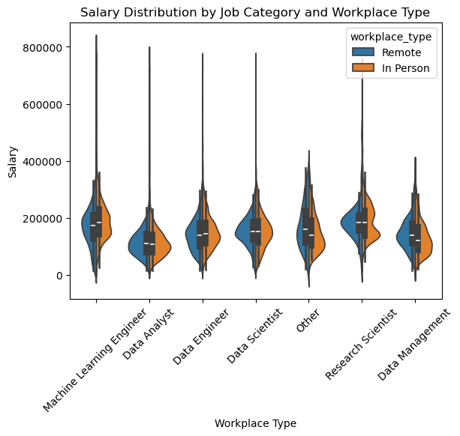
Notes:
Machine Learning Engineers have the highest salary range.
Data Analysts and Data Management roles have lower salary ranges.
Remote and in-person roles offer similar salary distributions.
Remote roles tend to pay slightly higher for some positions (e.g., Research Scientists).Specialized roles like Data Scientists and Engineers command higher salaries.
Salary distributions are mostly symmetrical, with fewer outliers.

Slide 13
logo
Team 2 Project
PART 4
Remote Work Opportunities

Slide 14
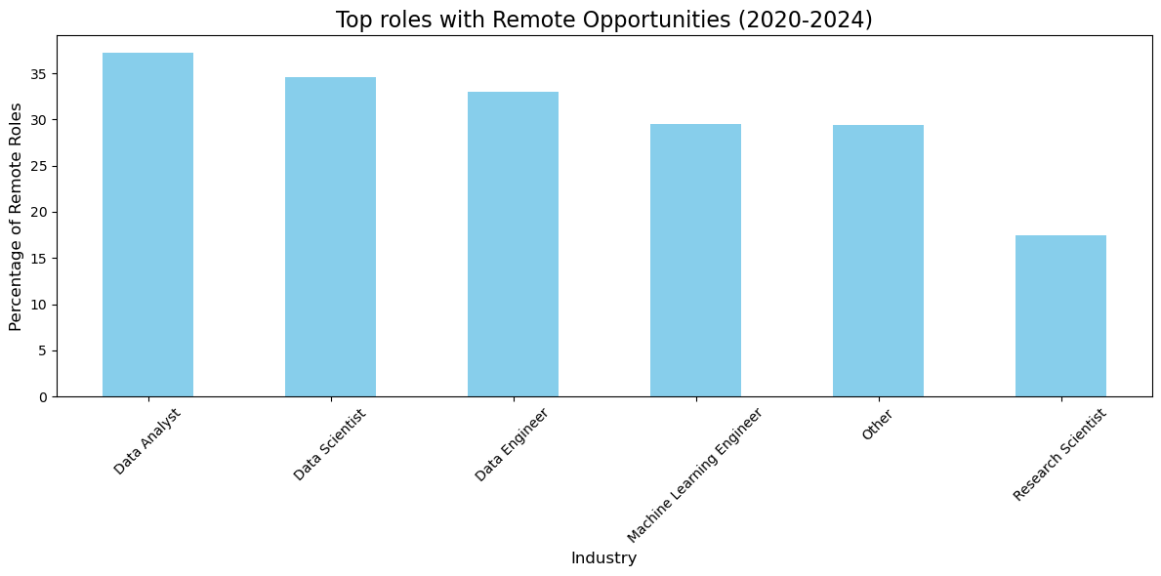
Job Categories with Remote Opportunities
(2020-2024)
industryPPTtemplatehttp://www.1ppt.com/hangye/
Notes:
Data Analysts, Data Scientists, and Data Engineers lead in remote job opportunities, with over 35% of roles offered remotely.
Machine Learning Engineers also have significant remote opportunities, slightly below Data Engineers.
Research Scientists have the lowest percentage of remote roles among the listed industries.
Remote opportunities are most prevalent in analytical and engineering-focused roles.

Slide 15
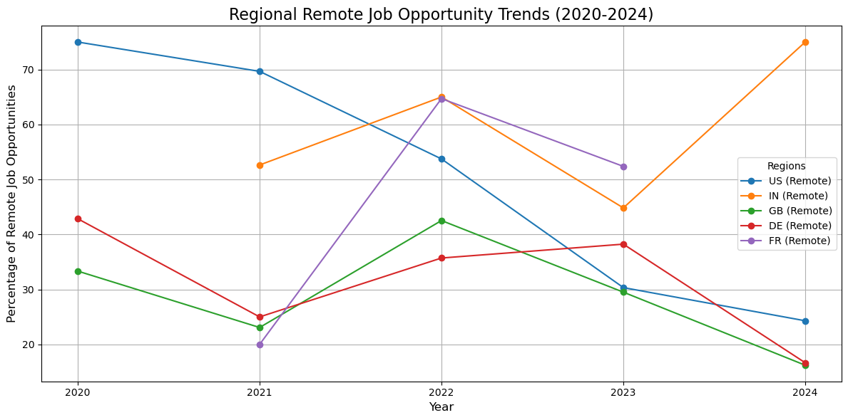
industryPPTtemplatehttp://www.1ppt.com/hangye/
Notes:
India (IN) shows a consistent increase in remote job opportunities, peaking in 2024.
France (FR) saw the most dramatic rise in remote roles by 2022 but experienced a decline afterward.
The United States (US) and Germany (DE) show declining trends in remote opportunities.
Great Britain (GB) maintains steady remote job growth but lags behind India and France by 2024.

Slide 16
industryPPTtemplatehttp://www.1ppt.com/hangye/
Notes:
Global remote job opportunities peaked in 2022, reaching over 50% of roles.
There has been a sharp decline in remote opportunities since 2022, dropping to about 25% by 2024.
The trend reflects a potential shift back to in-person or hybrid work models globally.

Slide 17
logo
Team 2 Project
PART 4
Career Pathways
and Job Titles

Slide 18
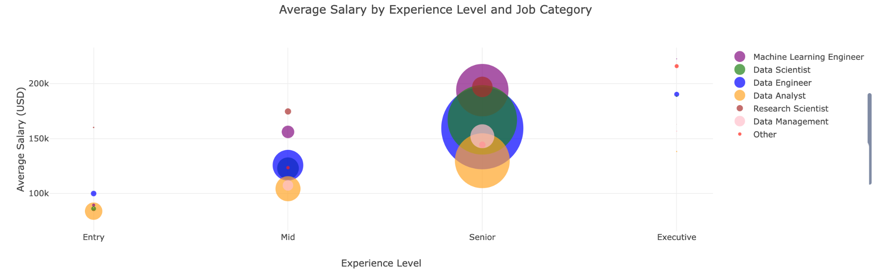
Job Category Distribution by Experience Level
Notes:
Senior roles dominate across all job categories, with Data Scientists and Data Engineers leading the counts.
Mid-level positions also have significant representation, especially for Data Analysts and Data Scientists.
Entry-level and Executive roles have the lowest counts, reflecting fewer opportunities for these experience levels.
Specialized roles like Machine Learning Engineers are more prevalent at senior and mid-levels.

Slide 19
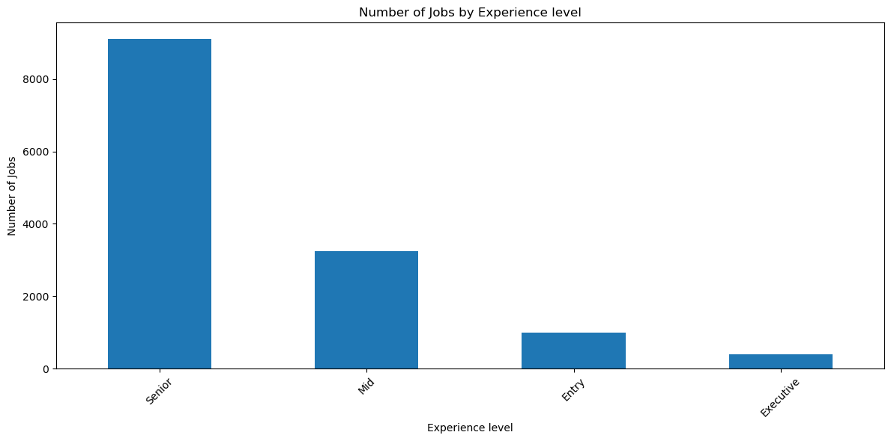
Number of Jobs by Experience Level
Key Findings
73%
60%
01
Senior-level roles dominate the job market.
58%
51%
02
Mid-level are next most available.
03
Entry-level and Executive have the least availability.
Q1
Q2
Q3
Q4

Slide 20
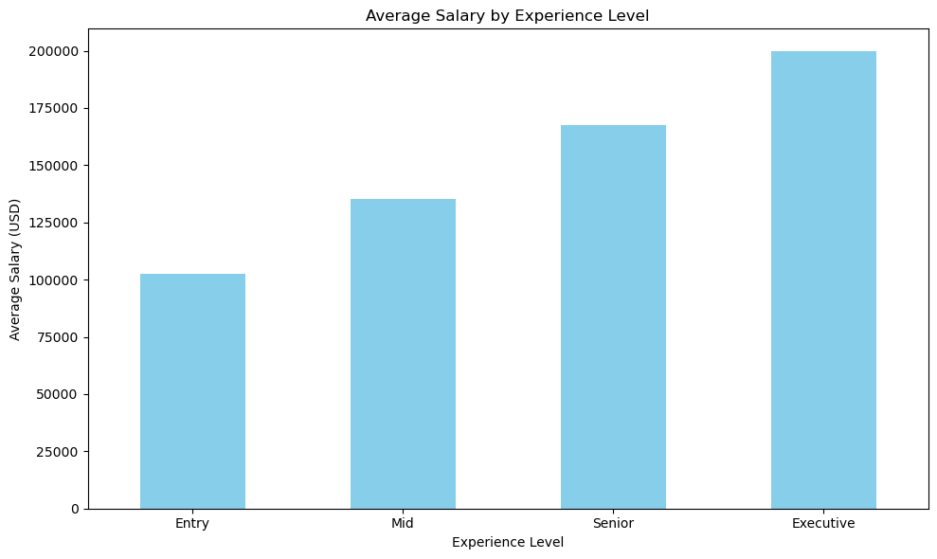
Average Salary by Experience Level
Key Findings
73%
01
Executive roles command the highest average salary, nearing $200,000.
60%
58%
51%
02
Salaries increase steadily with experience, reflecting the value of seniority and expertise.
03
Entry-level positions have the lowest average salary, around $100,000, while mid and senior roles show progressive growth.
Q1
Q2
Q3
Q4

Slide 21
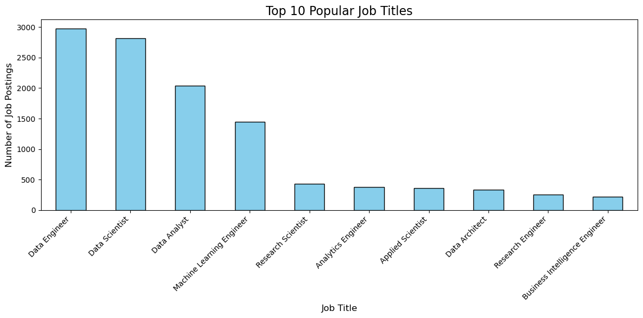
Top 10 Popular Job Titles in Data Science
Key Findings
73%
01
Data Engineer and Data Scientist are the most in-demand jobs
60%
58%
51%
02
Data Analyst and Machine Learning Engineer rank highly
03
Specialized roles like Research Scientist and Data Architect have fewer postings
04
Business-focused roles are comparatively lower
Q1
Q2
Q3
Q4

Slide 22
logo
Team 2 Project
PART 5
Final Thoughts

Slide 23

Recommendation
Focus on developing skills
Leverage senior-level opportunities
Aim for mid-size companies
Consider targeting positions from countries like India for emerging remote opportunities.
Notes:
in high-demand roles like Data Engineer and Machine Learning Engineer.
as they dominate the market, with lucrative salaries across industries.
Invest in continuous upskilling to align with industry trends and specialized job categories.

Slide 24
logo
Team 2 project
Q/A
https://www.freeppt7.com

Slide 25
logo
Team 2 project
Thank you
https://www.freeppt7.com

